Slide 1
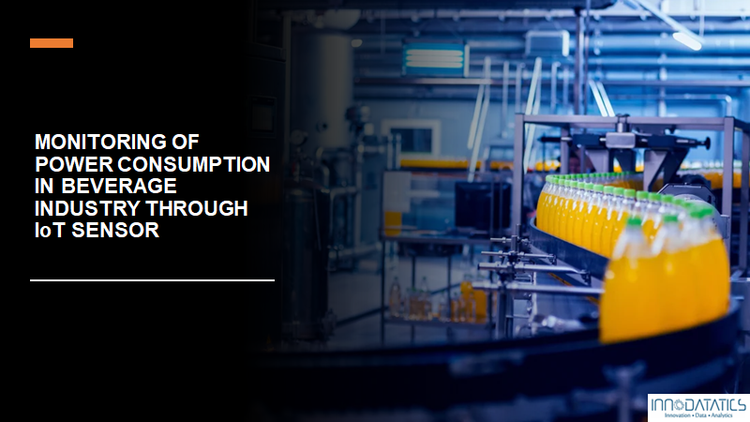


Slide 2





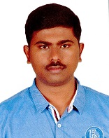
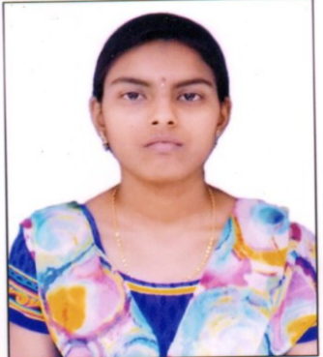


Team
Akshay Avinash Jagtap
https://www.linkedin.com/in/jagtapakshay444
Anandakrishnan K V https://www.linkedin.com/in/anandakrishnan-kv-01597612b
Aniket Annam
https://www.linkedin.com/in/aniket-annam-560956166/
Apurva C
https://www.linkedin.com/in/apurva-c-573324203
Sudharshan P https://www.linkedin.com/in/ponguluri-sudharshan-7b380b158/
Harinath D S
https://www.linkedin.com/in/harinath-d-s-0a4a523a/
Harsha Sri Lekha B
www.linkedin.com/in/harsha-sri-lekha-066760214
Kapil Dev Singh
https://www.linkedin.com/in/kapil-dev-singh-5041b17b/

Slide 3







Team
Mahak Mahnot
http://linkedin.com/in/mahak-mahnot-362b231ba
Rama Krishna Rallabandi
https://www.linkedin.com/in/ramakrishna-r-a1897bb3/
Reeshabh Singh Thakur
https://www.linkedin.com/in/reeshbah-singh-thakur/
Shubham Khandare
https://www.linkedin.com/in/shubham-khandare-088871208
Teja Kumar Kotagiri
https://www.linkedin.com/in/teja-kumar-59b568199/
Venkatesh Kurapati
https://www.linkedin.com/in/kurapati-venkatesh-081910210/
Vrushali Hulikoppe
https://www.linkedin.com/in/vrushali-hulikoppe-54a8021b1

Slide 4
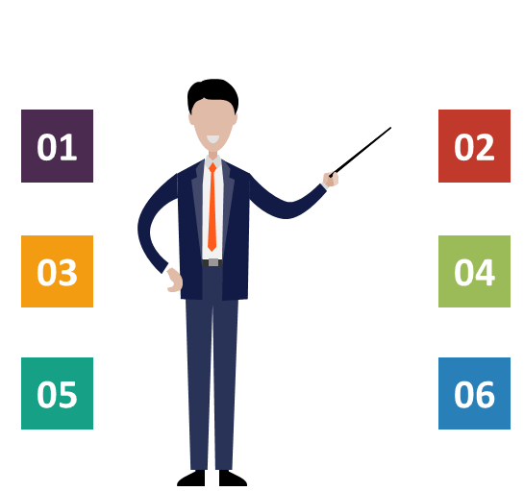
Contents
Project overview & Scope
Objectives and Constraints
CRISP-ML(Q) Methodology
Technical Stack
Project Architecture
Success Criteria
Data Collection and description
07
08
Data Understanding
Model Selection & Building
09
10
Deployment

Slide 5
Project Overview
The project focuses on monitoring the power consumption in beverage industry through IoT sensor
It has been observed that most of the power consumption depends upon the electrical motors installed in the various units of the beverage plant so this project will work with the data associated with it.
After Monitoring by analysing the pattern from the data, the project will then give insights about the efficiency in the power consumption by the whole beverage plant
Scope
The IoT enabled monitoring of power consumption helps in giving various insights which can help in deciding the units that can be run simultaneously or that can be shut off to maintain an optimal power consumption and hence can play a vital role in reduction of electricity bill.
Each motor’s and total plant power consumption have some relation, that in turn indicates rate of power losses happening in different sections of plant. Such information will helps to satisfy predictive maintenance, replacement of inefficient devices and cables, and going for proper load management.

Slide 6


Project Goal
To reduce power consumption in beverage industry by monitoring industry equipment's and component using IoT sensors, targeting the overloaded equipment's and reporting the maintenance requirement for the equipment which will lead to significant energy reductions.
Constraints:
Objectives:
Monitoring of electrical power consumption through IoT Sensor
Maximize energy efficiency
Minimize the power losses and overloading
Electrical energy consumption by individual motors from the different units of the beverage plant
Security of the data
Working of sensor

Slide 7
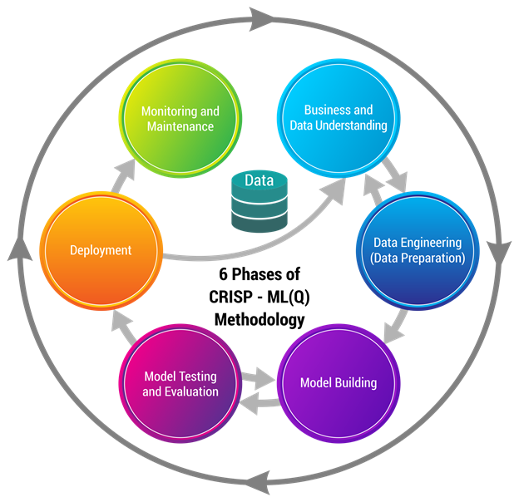
CRISP-ML(Q) Methodology

Slide 8
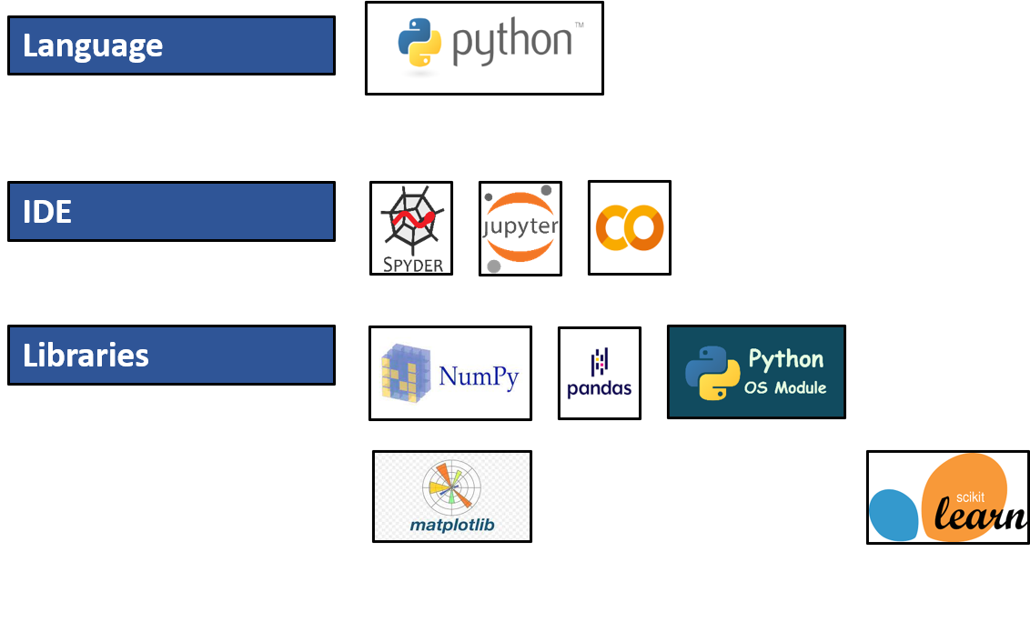







Technical Stacks
Python : High-Level Programming Language
Spyder, Jupyter, Collab, Atom: IDE (For application development)
NumPy, Pandas, SciPy, Matplotlib, Seaborn, Scikit learn, Stats models: Developing machine learning,
data science, data visualization, image & data manipulation applications.
Flask, Heroku, Html: Used to deploy the model

Slide 9
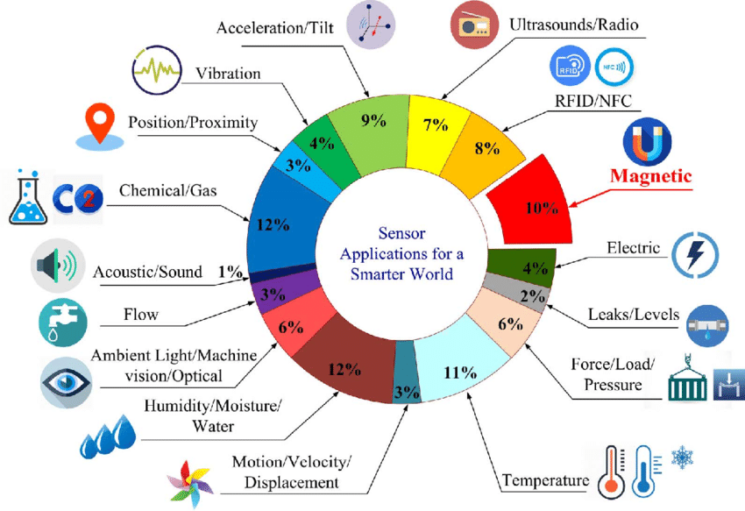
Different types of Iot sensor

Slide 10
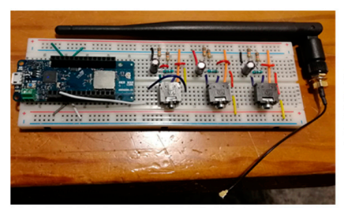
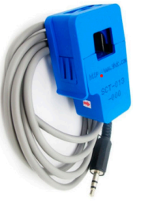
IoT sensor(Smart electric meter)
Three-phase LoRa (Long Range) current sensor and current transformer (CT) sensor

Slide 11

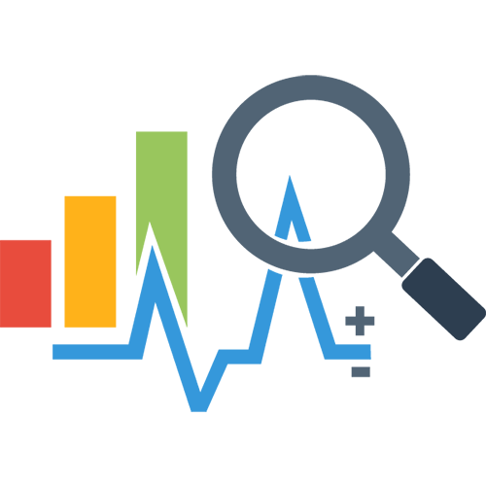




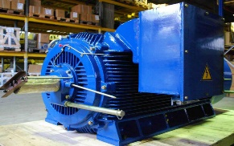


Project Architecture
Data Visualization
Data Preprocessing
Model Building
Preprocessed Data
Removing nominal features
Handling Missing values
Outlier Treatment
Binning of “All plant”
Classification Model
( Decision Tree )
( Target : Energy_consumption )
Split Train and Test
Exploratory Data Analysis ( EDA )
Imported Data
MySQL connector
Model Deployment
Model building for Train data
Finding the best model
Data Collection
Data from IoT Sensor
Model Evaluation
Predicted category of energy consumption
UI
IoT sensor

Slide 12
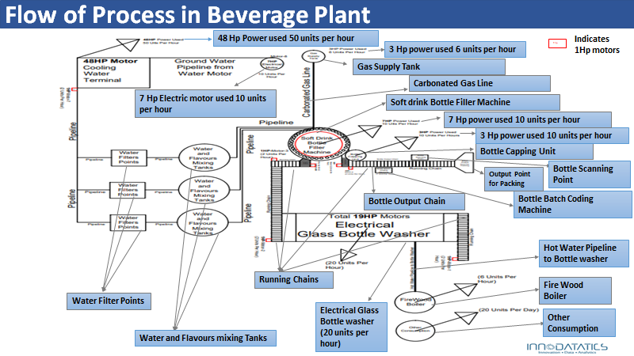
Flow of Process in Beverage Plant

Slide 13

Success Criteria
IoT enabled monitoring will reduce the manual task of keeping a check on electricity consumption and with this model whenever the energy consumption will be high , user will automatically get the report and hence immediate steps then can be taken to decrease the further consumption
It provides energy consumption data for each unit so this will give information about the unit at a particular instance which is decreasing the overall production efficiency
By the individual electricity consumption it also will help in keeping a check over functionality of the electrical component and hence will add positively towards the overall efficiency of the production system

Slide 14
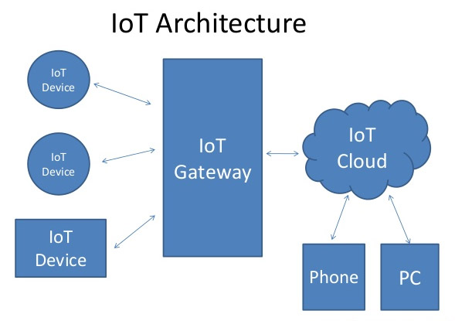
Data Collection and Description
Source of Data
IoT Sensor
Data is collected through various electric motors in the production on real time basis through the IoT sensor installed.
Electrical Energy consumed by individual motors installed in individual unit of the production system acts as independent variables and another meter is installed at the outlet of production system that measures overall electricity consumption acts as a target variable.

Slide 15
Data Understanding
In the dataset the data is calculated for every 10 seconds i.e. energy in watts consumed by each of the above mentioned unit in 10 seconds.
Calculation = ((energy in kWh x 1000)/60 x 60) x 10
Data Dictionary
Name of the Feature | Description | Nature | Type of Variable
Timestamp | Timestamp of the monitoring | Qualitative | Nominal
RCM | Energy consumption by motors installed on running chain | Quantitative | Continuous
CWT | Energy consumption by motors on cooling water terminal | Quantitative | Continuous
M10HP3 | Carbonated Gas Line – 3HP | Quantitative | Continuous
M11HP3 | Bottle Capping Unit – 3 HP | Quantitative | Continuous
M12HP7 | Soft Drink Bottle Filler Machine – 7 HP | Quantitative | Continuous
M13HP19 | Electrical Glass Bottle Washer – 19 HP | Quantitative | Continuous
FWB | Firewood Boiler – 6 KWH | Quantitative | Continuous
OC | Other Consumption – 20 KWH | Quantitative | Continuous
BBCM | Bottle Batch Coding Machine – 1 KWH | Quantitative | Continuous
Allplant | Overall energy consumption in the plant | Quantitative | Continuous

Slide 16

Data Preparation
Exploratory Data Analysis
Data Visualization
Binning of output variable “allplant”
Removed “Timestamp” column
There is no Null, duplicate values in the dataset.
Higher the HP more the consumption.

Slide 17
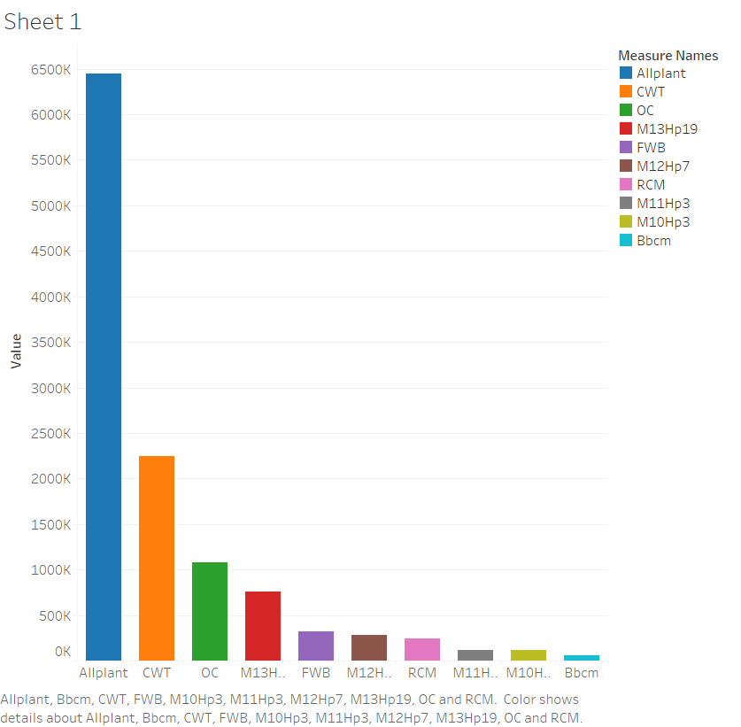
Univariate Analysis
CWT is consuming higher power and BBCM is consuming the least power consumption. So , mainly CWT , OC and M13HP19 are contributing in “Allplant”

Slide 18
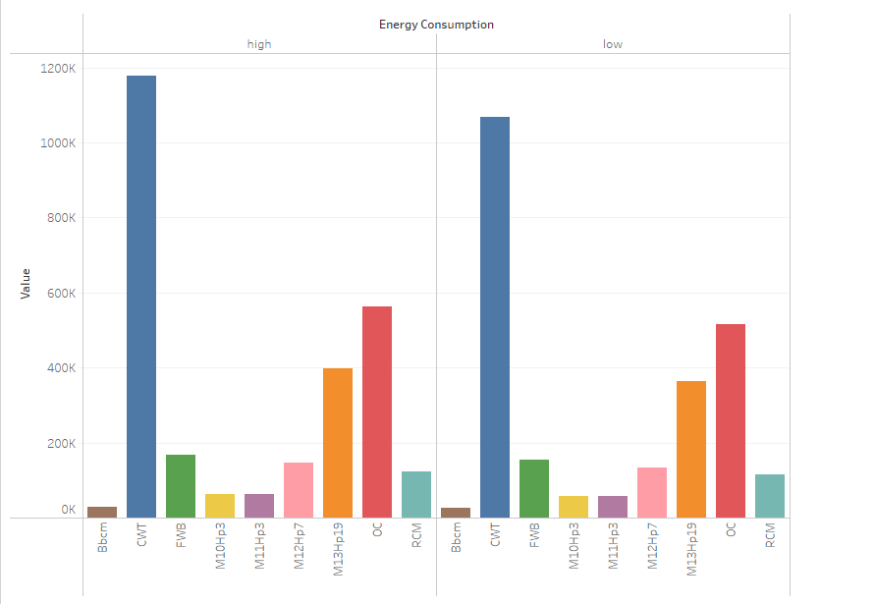
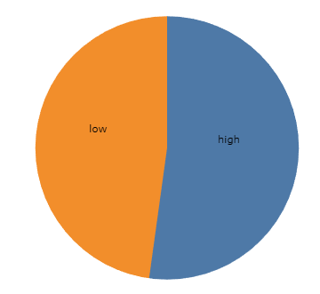
Univariate Analysis
Distribution of data points in the categories of energy consumption
Distribution of the data points in each feature in the categories of energy consumption is nearly the same i.e. the proportion of data points falling in low and high consumption is nearly the same.

Slide 19
Modelling
REGRESSION
CLASSIFICATION
Multilinear Regression
Decision Tree Classification
Lasso Regression
Models
K nearest neighbor (KNN)
Random Forest Regression

Slide 20
Model Selection
Regression Models
Model | Train Error (RMSE) | Test Error (RMSE) | R-squared value
Multi Linear Regression | 8.307 | 8.420 | .001
Lasso | 8.345 | 8.298 | 0.00
Ridge | 8.338 | 8.298 | .001
All the models above are giving low R-squared value. So, these are not acceptable.
Classification Models
Model | Train Accuracy | Test Accuracy | Remarks
Decision Tree | 97% | 93.1% | Nearly a Right Fit Model and faster performance
KNN | 91% | 92% | Train accuracy is lower and slow performance
Decision Tree is the best among all the above mentioned models.

Slide 21
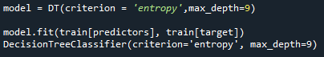
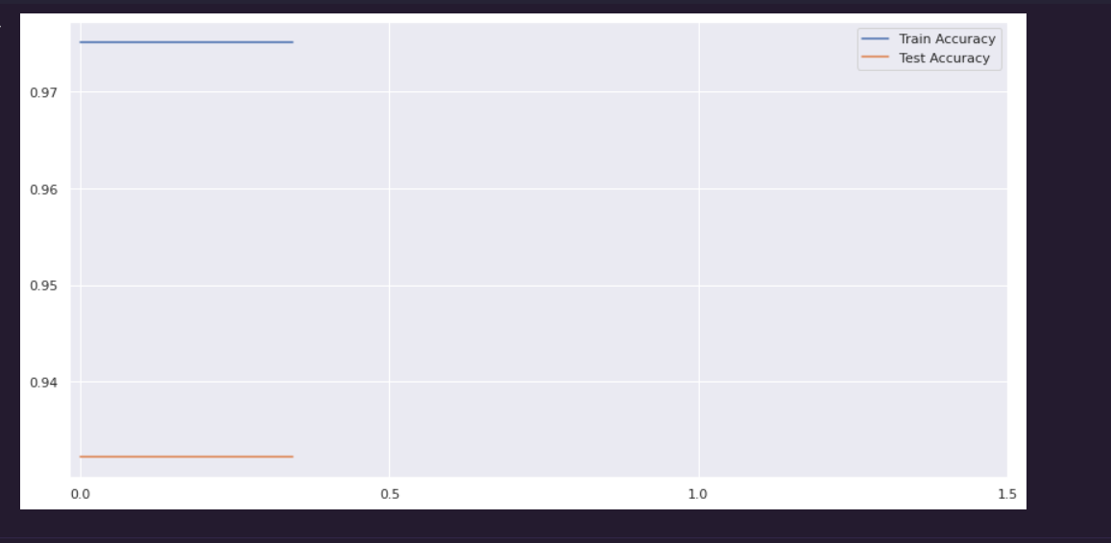
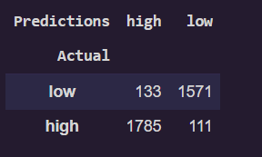
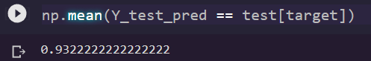
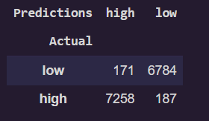
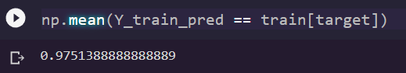
Model Building
Model Parameters:
Prediction on Test data & Train Accuracy
Prediction on Train data & Train Accuracy

Slide 22



Deployment Strategy
In the Deployment, we have used the following tools:
Python
Python Flask
Html & CSS.
A tool used for Manipulation of data and model deployment using different libraries and Modules like Pandas, Flask , stats models.
Python Flask is an open-source python library that makes it easy to create custom web apps for machine learning and data science. It is classified as a microframework because it does not require particular tools or libraries. it has no database abstraction layer, form validation, or any other components where pre-existing third party libraries provide common functions.
HTML (hyper text markup language) is use for making structure of the website to take inputs manually from the user.
CSS (Cascading Style sheet) is used for describing the presentation of the html document or styling the html structure to make it look good.

Slide 23


Deployment Strategy
Heroku
GitHub
Heroku is platform as a service(PaaS) that enables developers to build, run and operate application entirely in the cloud
Heroku integrates with GitHub to make it easy to deploy code living on GitHub to apps running on Heroku. When GitHub integration is configured for the Heroku app, Heroku can automatically build and release( is the build is successful) pushes to specified GitHub Repository

Slide 24
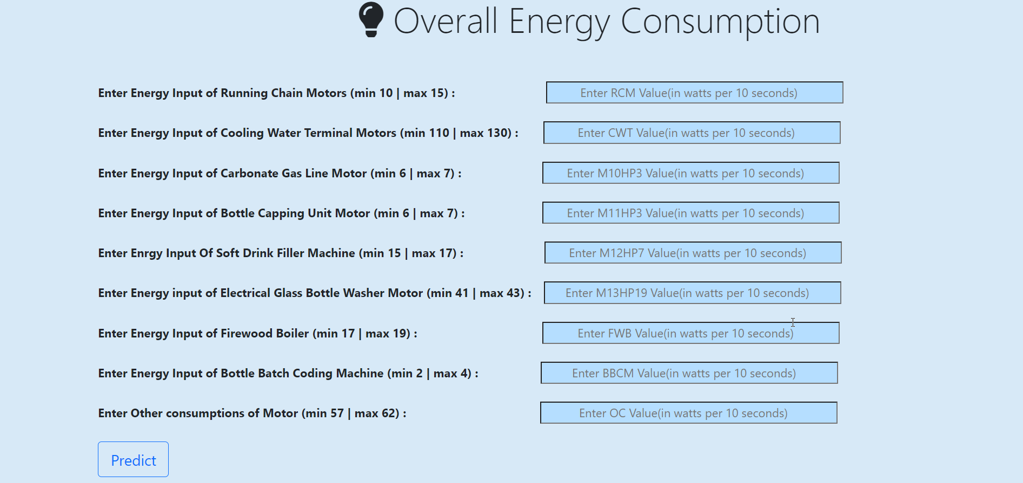
Deployment View
We have to enter energy consumption of motors in watts per 10 seconds that are collected from the IoT used in the industry and after clicking Predict Button we get output whether the energy consumption is Low or High.

Slide 25
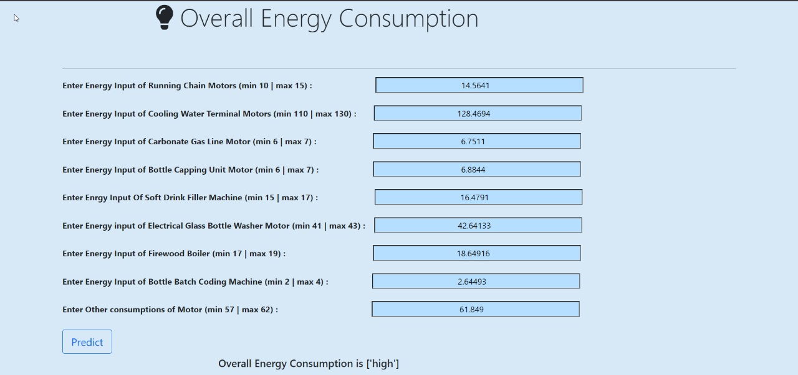
Output
When user inputs the value of different features based on that it is showing the output as
“ High consumption “.

Slide 26
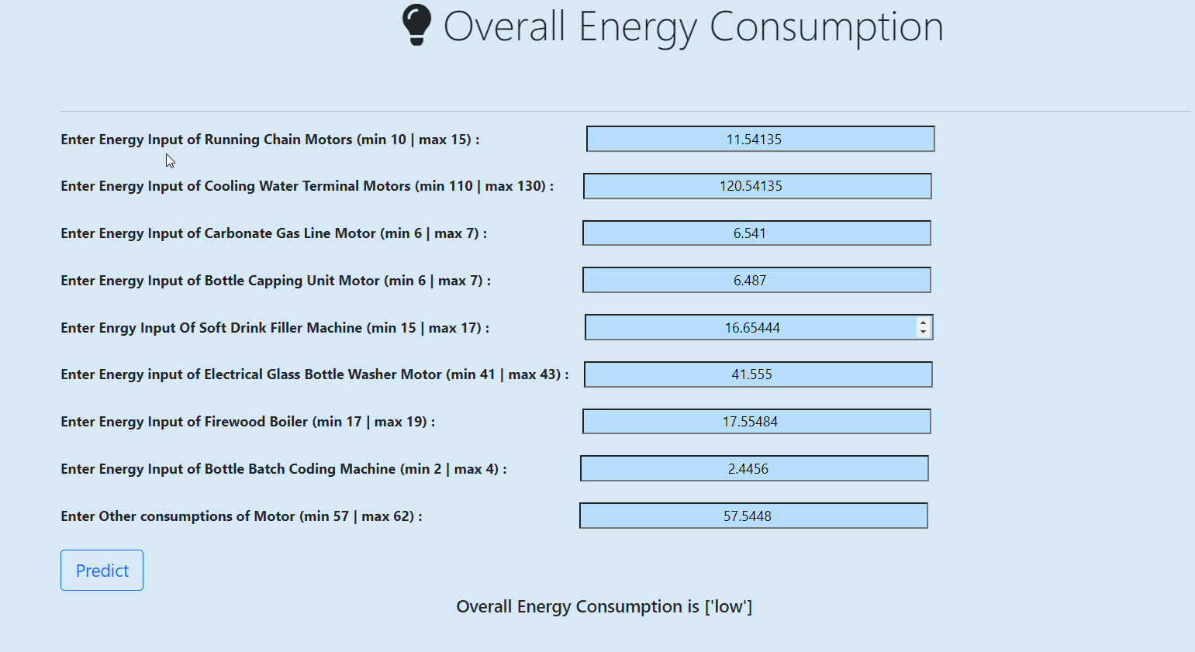
Output
When user inputs the value of different features based on that it is showing the output as
“ Low consumption “.

Slide 27

Conclusion
The model will help to predict all plant electrical power consumption meter reading as "high" & "low" in accordance with a threshold value for power consumption under constant production rate.
At constant production rate, if overall plant power consumption crosses the threshold value limit then it will indicate increased power losses happening in plant due to less efficient electrical part or devices. The model will predict such situations as output power consumption category in "high".
Such predictions of model will enables the plant operators to enforce predictive maintenance on un-efficient electrical parts of plant and rectify extra power losses issues.

Slide 28


